Slide 1
Using Dummy Variables
In Other Cases
An extra example (NOT for our exam)

Slide 2
The Baseline Case
Up to this point, we’ve talked about using dummy variables to determine relative effects
To illustrate this, we’ve considered relatively straightforward cases. Let’s recall what we’ve covered so far…

Slide 3
The Baseline Case
In our first in-class example, we compared a sample of male and female workers at a firm to explore whether or not they are paid differently.
And in this case, we knew that male workers earned $20/hour on average, while female workers earn $17/hour on average.

Slide 4
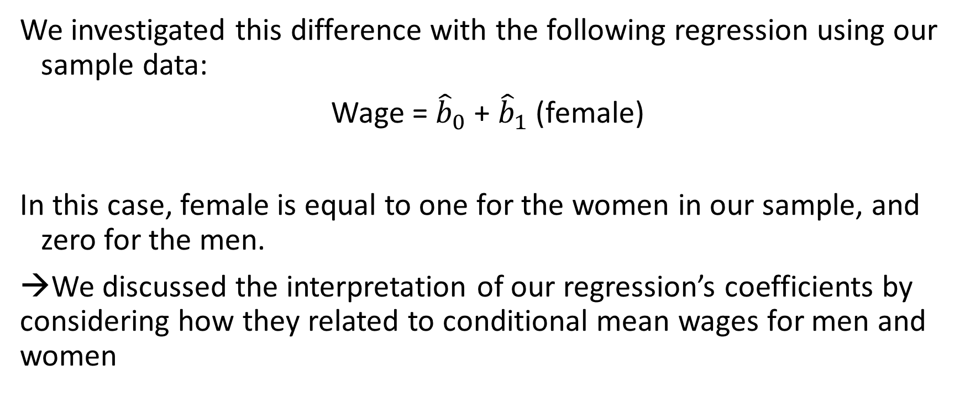
The Baseline Case
We investigated this difference with the following regression using our sample data:
Wage = ${\hat{b}}_{0}$ + ${\hat{b}}_{1}$ (female)
In this case, female is equal to one for the women in our sample, and zero for the men.
→We discussed the interpretation of our regression’s coefficients by considering how they related to conditional mean wages for men and women

Slide 5
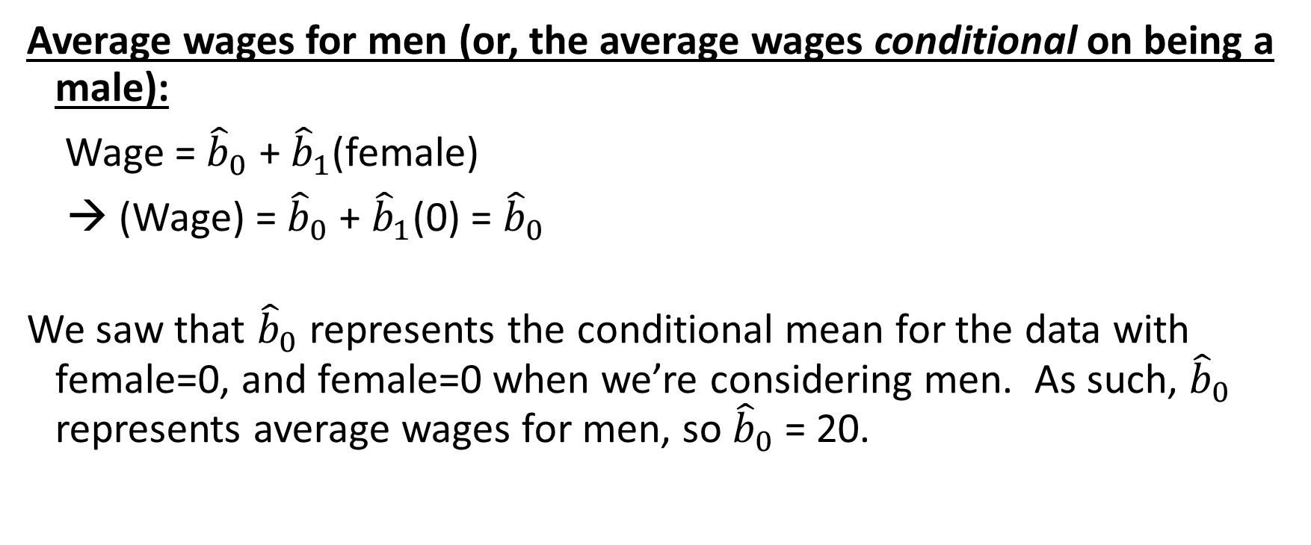
The Baseline Case
Average wages for men (or, the average wages conditional on being a male):
Wage = ${\hat{b}}_{0}$ + ${\hat{b}}_{1}$(female)
→ (Wage) = ${\hat{b}}_{0}$ + ${\hat{b}}_{1}$(0) = ${\hat{b}}_{0}$
We saw that ${\hat{b}}_{0}$ represents the conditional mean for the data with female=0, and female=0 when we’re considering men. As such, ${\hat{b}}_{0}$ represents average wages for men, so ${\hat{b}}_{0}$ = 20.

Slide 6
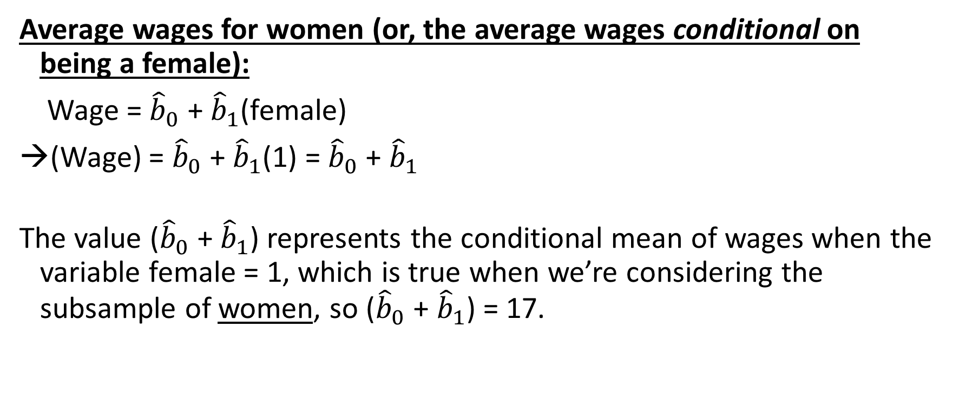
The Baseline Case
Average wages for women (or, the average wages conditional on being a female):
Wage = ${\hat{b}}_{0}$ + ${\hat{b}}_{1}$(female)
→(Wage) = ${\hat{b}}_{0}$ + ${\hat{b}}_{1}$(1) = ${\hat{b}}_{0}$ + ${\hat{b}}_{1}$
The value (${\hat{b}}_{0}$ + ${\hat{b}}_{1}$) represents the conditional mean of wages when the variable female = 1, which is true when we’re considering the subsample of women, so (${\hat{b}}_{0}$ + ${\hat{b}}_{1}$) = 17.

Slide 7
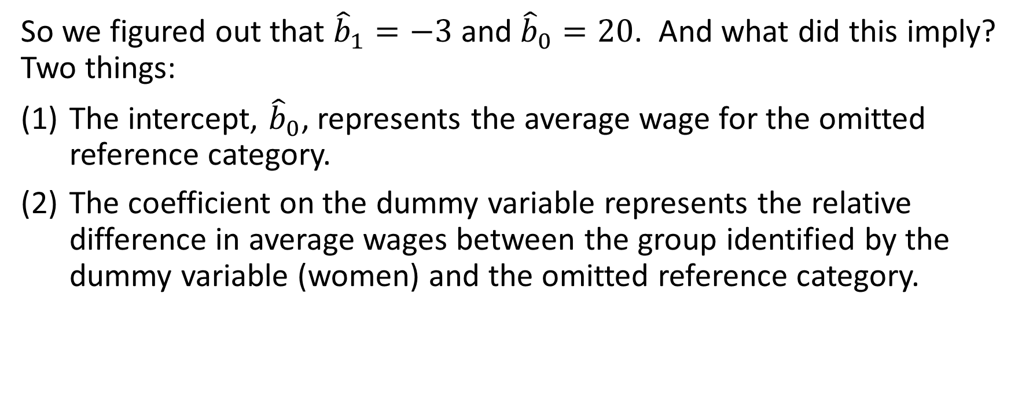
The Baseline Case
So we figured out that ${\hat{b}}_{1}=−3$ and ${\hat{b}}_{0}=20$. And what did this imply? Two things:
The intercept, ${\hat{b}}_{0}$, represents the average wage for the omitted reference category.
The coefficient on the dummy variable represents the relative difference in average wages between the group identified by the dummy variable (women) and the omitted reference category.

Slide 8
The Advanced Case
But now suppose that we wanted to consider a more nuanced case. Suppose that we worried that the firm is underpaying red-haired women a lot more than other women. And suppose that we use a pivot table in Excel to compute the following average wages:
Note that the average wage for ALL women is still $17 – it’s just that red-haired women appear to earn less relative to non-red-haired women
Average wages for men | $20
Average wages for red-haired women | $15
Average wages for non-red-haired women | $18

Slide 9
The Advanced Case
Wow – what does our firm have against red-haired women? Well, to properly investigate this, we’d need to use a regression. And our instincts may tell us that we can use dummy variables here, too, but how would could we do that? Well, we’d need to specify two new dummy variables:
“RH Female” is equal to one if the person is a red-haired female, and zero if she is EITHER a man OR a non-red-haired female
“NRH Female” is equal to one if the person is a non-red-haired female, and zero if she is EITHER a man OR a red-haired female

Slide 10
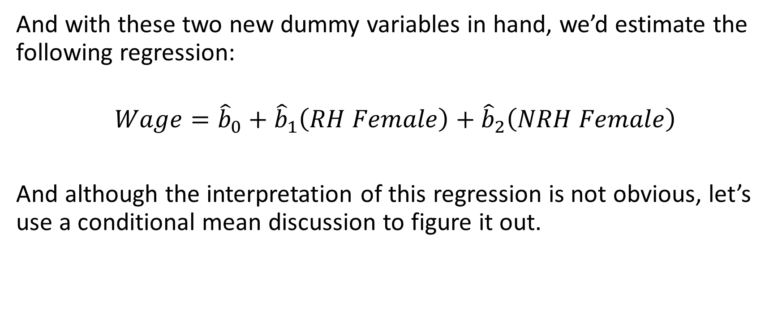
The Advanced Case
And with these two new dummy variables in hand, we’d estimate the following regression:
$$Wage={\hat{b}}_{0}+{\hat{b}}_{1}\left(RH Female\right)+{\hat{b}}_{2}\left(NRH Female\right)$$
And although the interpretation of this regression is not obvious, let’s use a conditional mean discussion to figure it out.

Slide 11
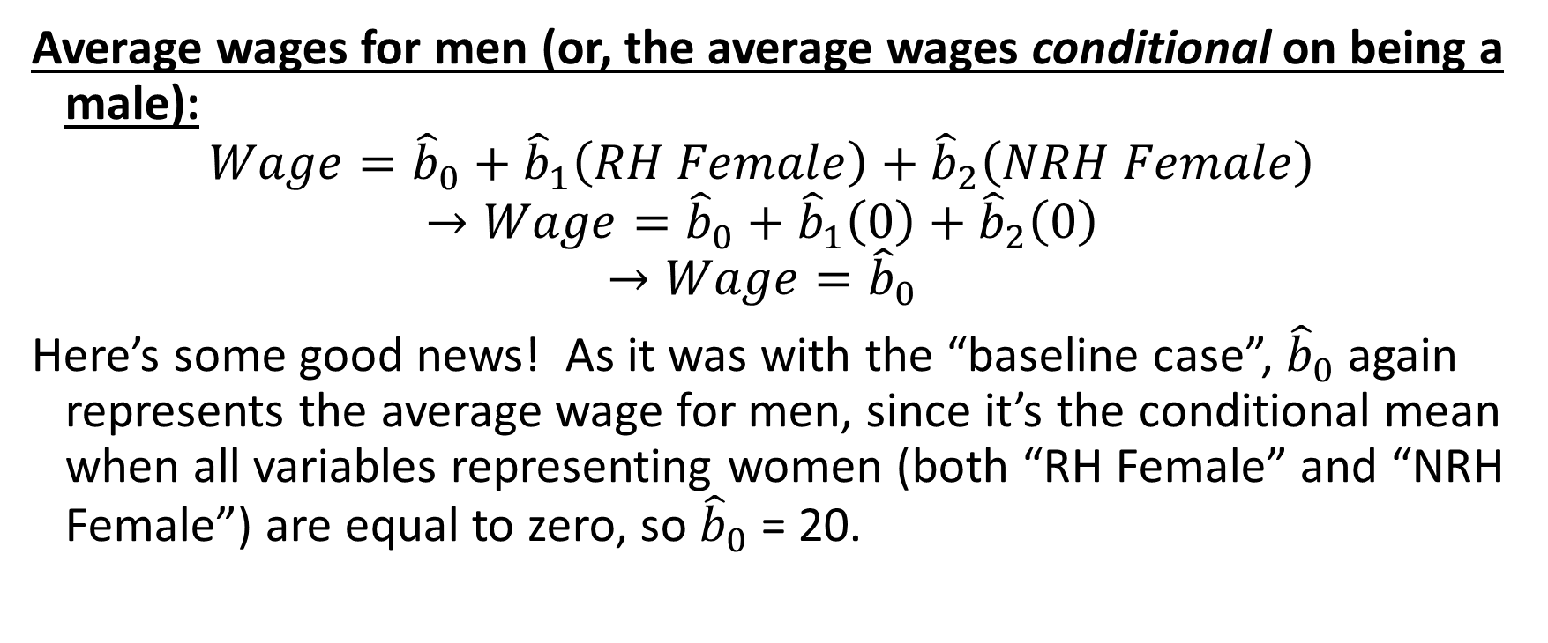
The Advanced Case
Average wages for men (or, the average wages conditional on being a male):
$$Wage={\hat{b}}_{0}+{\hat{b}}_{1}\left(RH Female\right)+{\hat{b}}_{2}\left(NRH Female\right)$$
$$→Wage={\hat{b}}_{0}+{\hat{b}}_{1}\left(0\right)+{\hat{b}}_{2}\left(0\right)$$
$$→Wage={\hat{b}}_{0}$$
Here’s some good news! As it was with the “baseline case”, ${\hat{b}}_{0}$ again represents the average wage for men, since it’s the conditional mean when all variables representing women (both “RH Female” and “NRH Female”) are equal to zero, so ${\hat{b}}_{0}$ = 20.

Slide 12
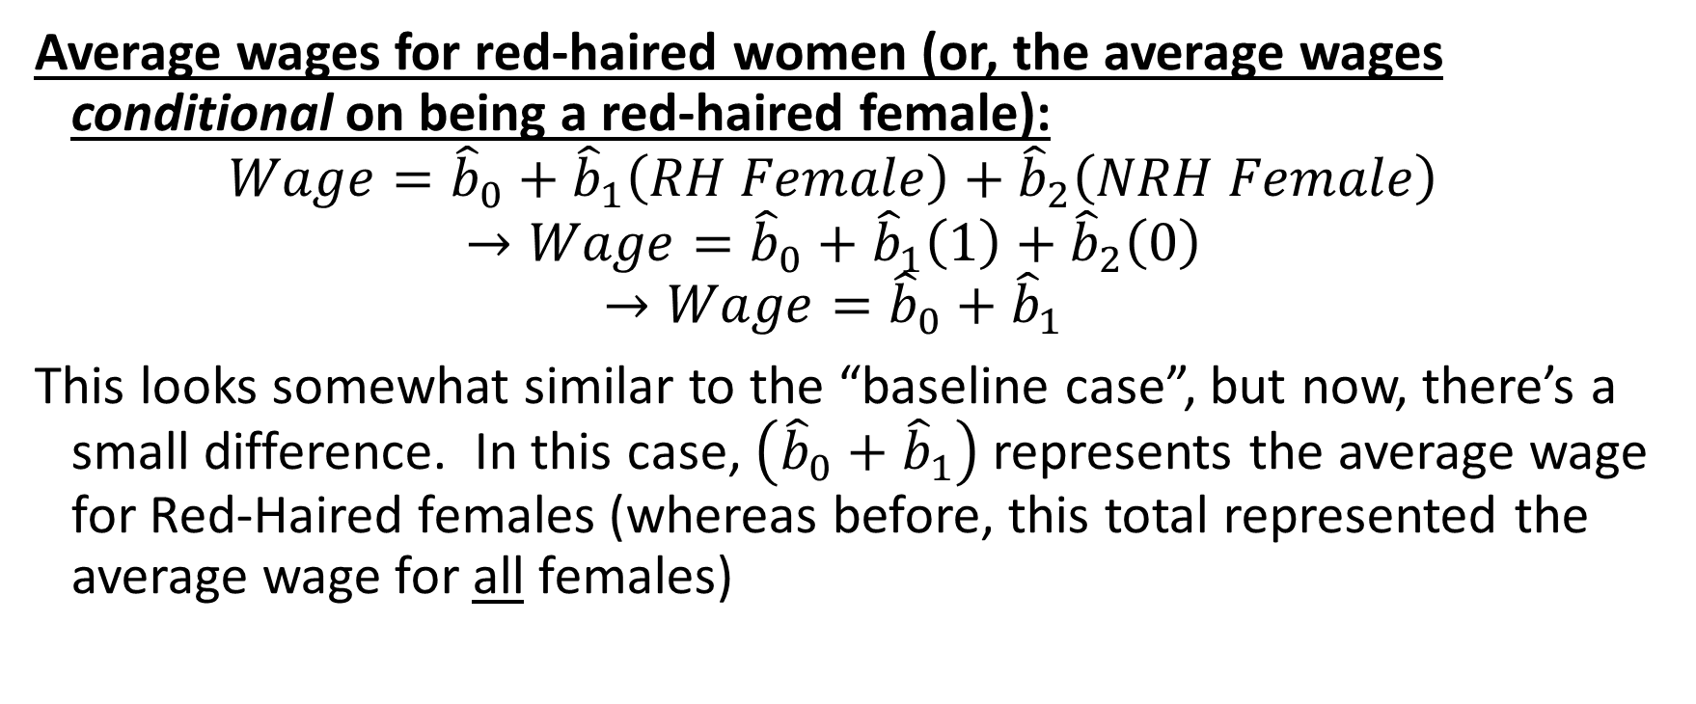
The Advanced Case
Average wages for red-haired women (or, the average wages conditional on being a red-haired female):
$$Wage={\hat{b}}_{0}+{\hat{b}}_{1}\left(RH Female\right)+{\hat{b}}_{2}\left(NRH Female\right)$$
$$→Wage={\hat{b}}_{0}+{\hat{b}}_{1}\left(1\right)+{\hat{b}}_{2}\left(0\right)$$
$$→Wage={\hat{b}}_{0}+{\hat{b}}_{1}$$
This looks somewhat similar to the “baseline case”, but now, there’s a small difference. In this case, $\left({\hat{b}}_{0}+{\hat{b}}_{1}\right)$ represents the average wage for Red-Haired females (whereas before, this total represented the average wage for all females)

Slide 13
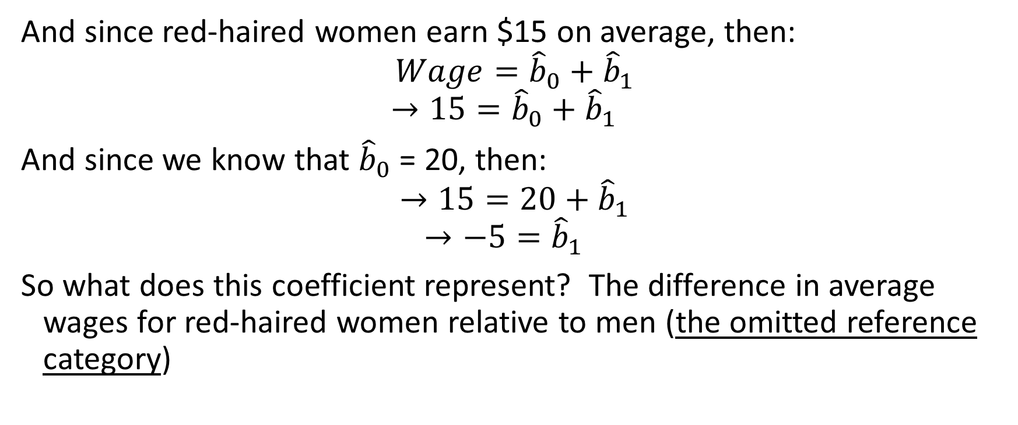
The Advanced Case
And since red-haired women earn $15 on average, then:
$$Wage={\hat{b}}_{0}+{\hat{b}}_{1}$$
$$→15={\hat{b}}_{0}+{\hat{b}}_{1}$$
And since we know that ${\hat{b}}_{0}$ = 20, then:
$$→15=20+{\hat{b}}_{1}$$
$$→−5={\hat{b}}_{1}$$
So what does this coefficient represent? The difference in average wages for red-haired women relative to men (the omitted reference category)

Slide 14
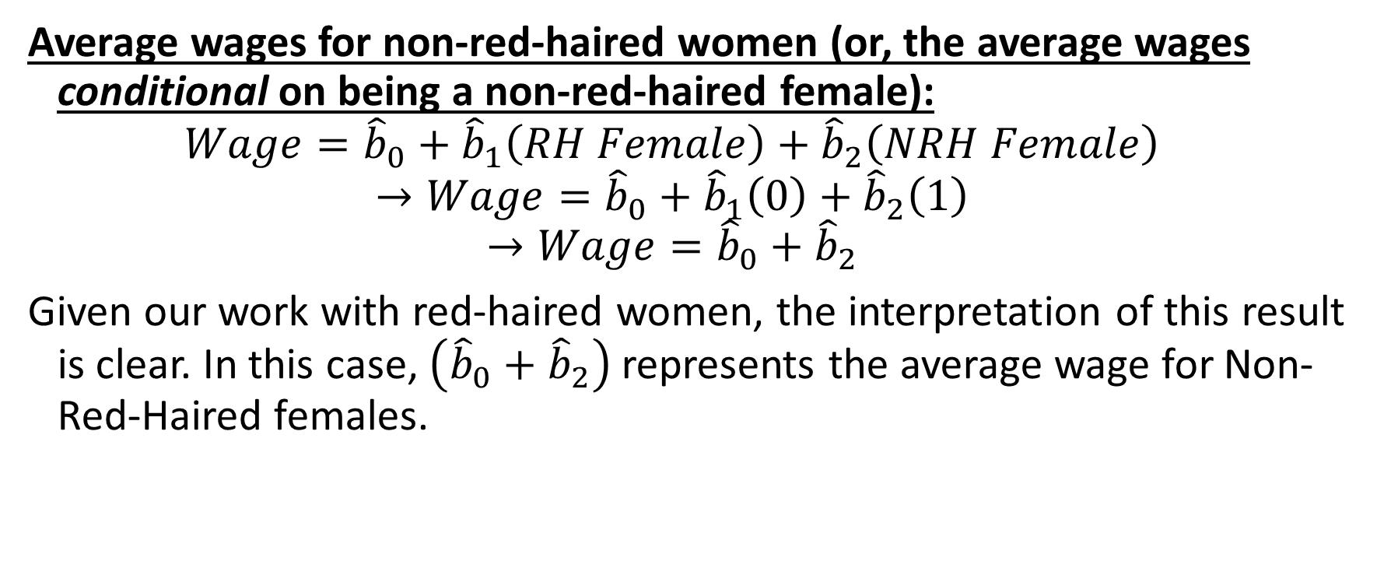
The Advanced Case
Average wages for non-red-haired women (or, the average wages conditional on being a non-red-haired female):
$$Wage={\hat{b}}_{0}+{\hat{b}}_{1}\left(RH Female\right)+{\hat{b}}_{2}\left(NRH Female\right)$$
$$→Wage={\hat{b}}_{0}+{\hat{b}}_{1}\left(0\right)+{\hat{b}}_{2}\left(1\right)$$
$$→Wage={\hat{b}}_{0}+{\hat{b}}_{2}$$
Given our work with red-haired women, the interpretation of this result is clear. In this case, $\left({\hat{b}}_{0}+{\hat{b}}_{2}\right)$ represents the average wage for Non-Red-Haired females.

Slide 15
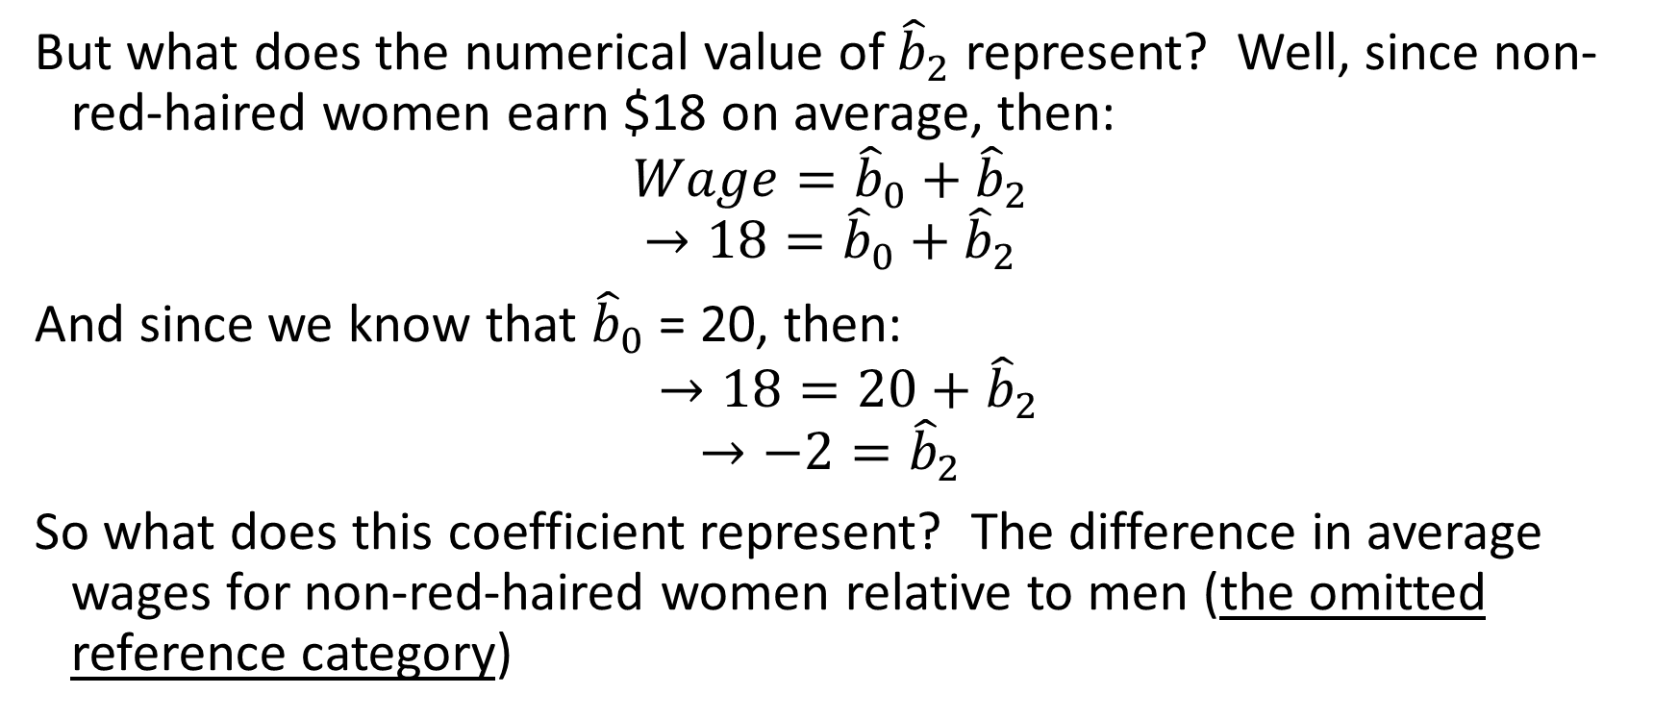
The Advanced Case
But what does the numerical value of ${\hat{b}}_{2}$ represent? Well, since non-red-haired women earn $18 on average, then:
$$Wage={\hat{b}}_{0}+{\hat{b}}_{2}$$
$$→18={\hat{b}}_{0}+{\hat{b}}_{2}$$
And since we know that ${\hat{b}}_{0}$ = 20, then:
$$→18=20+{\hat{b}}_{2}$$
$$→−2={\hat{b}}_{2}$$
So what does this coefficient represent? The difference in average wages for non-red-haired women relative to men (the omitted reference category)

Slide 16
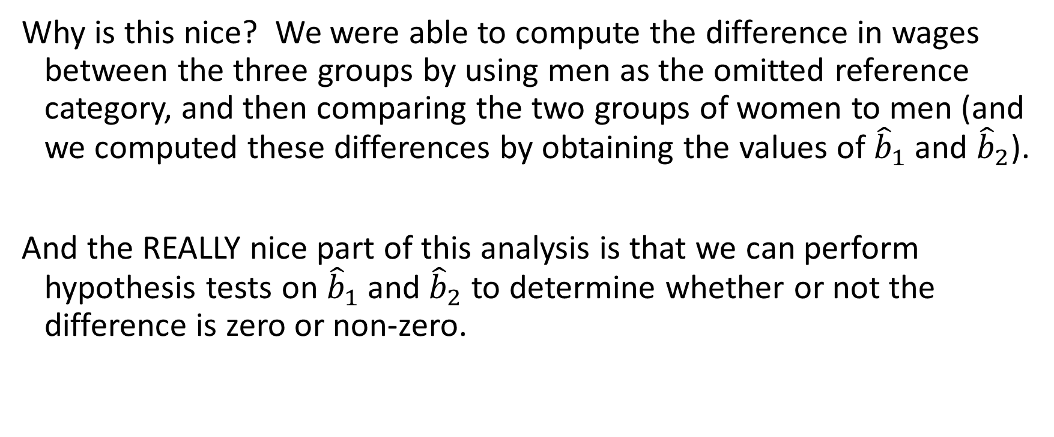
The Advanced Case
Why is this nice? We were able to compute the difference in wages between the three groups by using men as the omitted reference category, and then comparing the two groups of women to men (and we computed these differences by obtaining the values of ${\hat{b}}_{1}$ and ${\hat{b}}_{2}$).
And the REALLY nice part of this analysis is that we can perform hypothesis tests on ${\hat{b}}_{1}$ and ${\hat{b}}_{2}$ to determine whether or not the difference is zero or non-zero.

Slide 17
The most advanced, flexible case
This case can be generalized to compare as many different groups as you would like. For instance, suppose that you wanted to compare the wages of ten different groups of workers (or, even, ten individual workers). Then we would set up nine different dummy variables:
“Group1” is equal to one if the data pertains to the first group, and zero otherwise
“Group2” is equal to one if the data pertains to the second group, and zero otherwise
…
(9) “Group9” is equal to one if the data pertains to the ninth group, and zero otherwise

Slide 18
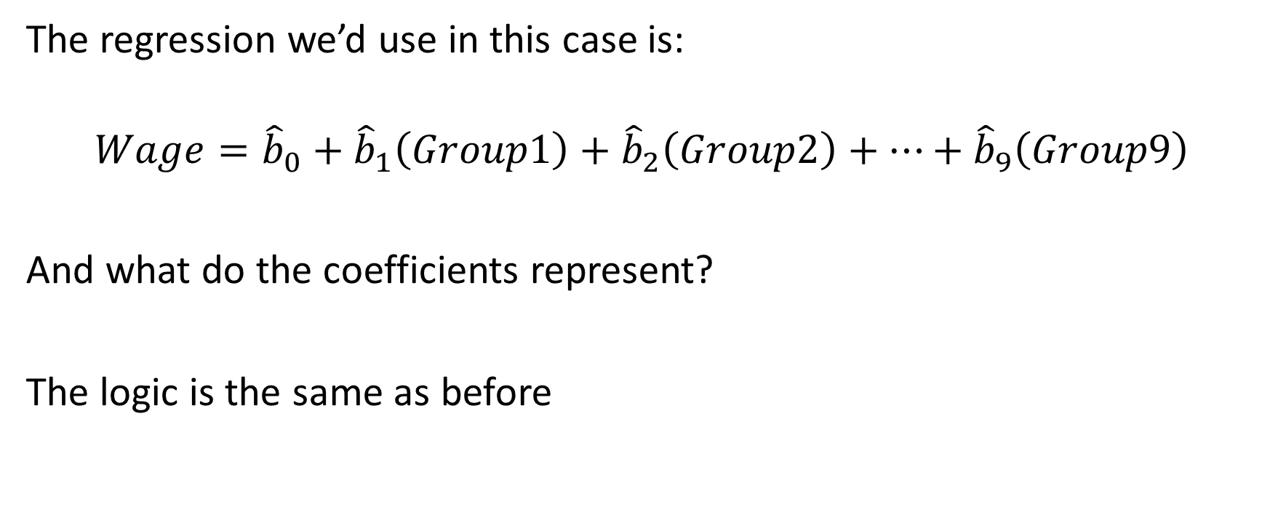
The most advanced, flexible case
The regression we’d use in this case is:
$$Wage={\hat{b}}_{0}+{\hat{b}}_{1}\left(Group1\right)+{\hat{b}}_{2}\left(Group2\right)+…+{\hat{b}}_{9}\left(Group9\right)$$
And what do the coefficients represent?
The logic is the same as before

Slide 19
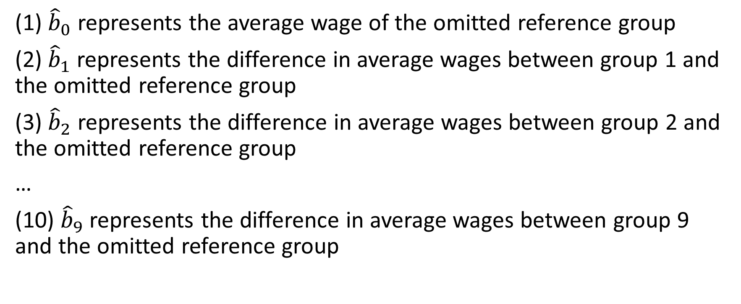
The most advanced, flexible case
(1) ${\hat{b}}_{0}$ represents the average wage of the omitted reference group
(2) ${\hat{b}}_{1}$ represents the difference in average wages between group 1 and the omitted reference group
(3) ${\hat{b}}_{2}$ represents the difference in average wages between group 2 and the omitted reference group
…
(10) ${\hat{b}}_{9}$ represents the difference in average wages between group 9 and the omitted reference group

Slide 20
The most advanced, flexible case
And as before, we can always test the null hypothesis that any of our coefficients are equal to zero. If we reject this null, then the difference is not zero. If we fail to reject this null, then the difference is (effectively) zero.

Slide 21
The Big Point
So what did this example show us?
If we have more than just two groups that we’d like to compare, it’s possible to use dummy variables to do it!
What we do is set up dummy variables for all but one of the groups (who will be the omitted reference category and will have their average Y represented by the intercept term), and the coefficient on each dummy will represent the average difference in the left-hand-side variable between the omitted reference group and the group represented by the dummy variable.

